Slide 1




Critical Thinking (BES-103)
Lecture 6
Arguments/Non-Arguments
Hadiqua Fazal
Assistant Professor
Computer Science Department

Slide 2
Lecture Outline
Agreement and Disagreement
Activity: Argument and Disagreement
Non-Arguments: Descriptions
Non-Arguments: Explanation
Distinguishing argument from other material

Slide 3
Agreement and Disagreement
▷ Argument is not the same as disagreement. You can disagree with someone else's position without pointing out why you disagree or persuading them to think differently.
▷ In critical thinking, there is a distinction between a position, an agreement, a disagreement, and an argument.

Slide 4
Agreement and Disagreement
▷ Position A point of view.
▷ Agreement To concur with some-one else's point of
view.
▷ Disagreement To hold a different point of view from someone else.
▷ Argument Using reasons to support a point of view, so that known or unknown audiences may be persuaded to agree.

Slide 5
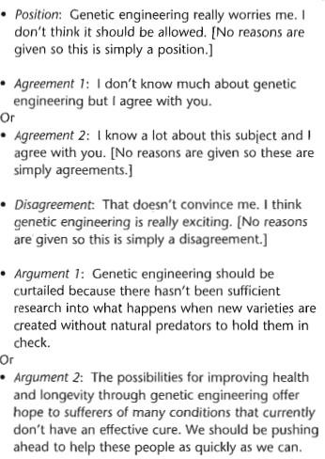
Agreement and Disagreement

Slide 6
Activity: Argument and Disagreement
Identify
▷ A. Argument, if so, why?
▷ B. Disagreement

Slide 7
▷ Passage 1
Activity: Argument and Disagreement
▷ Bilingualism and multilingualism confer many benefits. Speakers of more than one language have a better understanding of how languages are structured because they can compare across two different systems. People who speak only one language lack this essential point of reference. In many cases, a second language can help people to have a better understanding and appreciation of their first language.

Slide 8
▷ Passage 1
▷ Argument.
Activity: Argument and Disagreement
The overall argument is: and multilingualism confer
Bilingualism
many benefits. The reasons given are: (1) that speakers of more than one language have a better understanding of how languages are structured; (2) a second language can help to understand a first language.

Slide 9
Activity: Argument and Disagreement
▷ Passage 2
▷ Complementary therapies are an increasingly popular supplement to other forms of treatment.
Those who use these therapies argue that treatments such as reflexology, homeopathy and shiatsu complement the care provided by the medical profession. Indeed, some people claim that these therapies are more effective than traditional medicines. Anecdotal cases of miraculous cures abound and there are those who believe such methods can compete on equal terms with medical approaches. This just isn't convincing.

Slide 10
Activity: Argument and Disagreement
▷ Passage 2
▷ The final line expresses disagreement with the idea that complementary therapies are the equivalent of medical treatments. No reasons for this are given so this is not an argument.

Slide 11
▷ Passage 3
▷ Several young people die each year training for the
Activity: Argument and Disagreement
construction trades. Legislation is in place to cover health and safety at work, but some employers argue that this is too expensive to implement and onerous to monitor. They say that young people are not responsible enough at work and that there is nothing further they can do to prevent their deaths. That cannot be a good argument.

Slide 12
Activity: Argument and Disagreement
▷ Passage 3
▷ The final line expresses disagreement with the idea that employers cannot do more to help save lives in the workplace. No reasons for this are given so this is not an argument.

Slide 13
Activity: Argument and Disagreement
▷ Passage 4
▷ People are less politically aware now than they have been at any time in the past. For hundreds of years, people took great
personal risks to fight for causes that would benefit other people more than themselves. This rarely happens today. As late as the 1980s, there were frequent rallies with people in one country demonstrating to show solidarity with people elsewhere. Now, rallies are more likely to be for personal gain such as better salaries or student grants rather than for political issues of wider application. Even low risk activities such as voting in elections attract low turn-outs.

Slide 14
Activity: Argument and Disagreement
▷ Passage 4
▷ This is an argument. The conclusion is in the first line: People are less politically aware now than they have been at any time in the past. The reasons given are: (1) people used to fight for causes from which they didn't gain personally; (2) people took more risks for political issues; (3) rallies had a more international perspective; (4) fewer people vote now in elections.

Slide 15
Activity: Argument and Disagreement
▷ Passage 5
▷ Sea-levels have risen and fallen for generations, as have temperatures. Research suggests that global warming, if it is indeed occurring, is
primarily the result of natural changes in the earth's temperature and the effects of solar winds. It is now claimed that industrialisation and the burning of hydro-carbons have little effect upon climatic change. My contention is that arguments against global warming are dangerous.

Slide 16
Activity: Argument and Disagreement
▷ Passage 5
▷ The final line expresses disagreement with arguments against global warming. No reasons for this are given so this is not an argument.

Slide 17
Activity: Argument and Disagreement
▷ Passage 6
▷ I cannot agree with people who say that smacking children does them no harm. Of course it harms them, both physically and emotionally. Hitting another person is assault and it would not be
tolerated against an adult. Many adults have no sense of the cruelty of smacking precisely because they were smacked themselves as children and erroneously regard this as normal. They then go on to assault other vulnerable people, perpetuating a
vicious cycle.

Slide 18
Activity: Argument and Disagreement
▷ Passage 6
▷ Argument. The conclusion is in the second line: Of course, it harms them, both physically and emotionally, referring back to the issue in the first line about smacking. The reasons given to persuade us are (1) that it is assault; (2) assaults on adults are not accepted; (3) smacking perpetuates a cycle of violence.

Slide 19
Non-Arguments-Descriptions
▷ Descriptions give an account of how something is done, or what something is like. They do not give reasoned accounts of how or why something occurred nor do they evaluate outcomes.
▷ In reports and academic writing, description should be factual, accurate and free of value judgements.
▷ Descriptive detail is not intended to persuade to a point of view but aims, rather, to give the audience a more thorough impression of the item or issue being described.

Slide 20
Non-Arguments-Descriptions
▷ Example:
▷ The solution was placed in a test-tube and heated to 35" centigrade. Small amounts of yellow vapor were emitted. These were odorless. Forty milliliters
of water were added to the solution, which was
then heated until it began to boil. This time, grey steam was emitted. Water droplets gathered on the side of the test-tube. [This describes the steps taken in an experiment. Careful description of methodological procedures is an important part of writing up any kind of experimental research. No reasons are given for what happened.]

Slide 21
Non-Arguments-Descriptions
▷ Example:
▷ The painting depicts several figures gathered around a cottage
and in the fields. These figures are dressed in peasant dress. All
of them are located in the shadows either of the house or of the trees. It is not possible to make out any individual features on their faces or in their clothing. By contrast, the figures of the noblemen who commissioned the painting are dressed in fine and individualized apparel. These figures are all located in the foreground of the painting, in full sunshine, and their facial features are clearly distinguishable. [This passage describes some salient features of a landscape painting. The details that the author has chosen to select suggest a point of view.]

Slide 22
Non-Arguments-Descriptions
▷ Example:
▷ Usually, when people see an object that is familiar to them, such as an elephant, a tree, a bowl, a computer, they grasp
immediately what it is. They recognize the overall pattern that the object makes and don't need to work out from other sensory information such as sounds, smell and colour, what the whole object might be. However, people with a condition known as visual agnosia cannot see a whole pattern in this way: they cannot recognize objects visually. If they traced the outline of the object with their hand, they might recognize an elephant, but they can't see an elephant. They can see, and they know they are seeing something, but they can't see an elephant. [In this instance, the author is describing what the condition of visual agnosia is like.]

Slide 23
Non-Arguments-Explanation
▷ Explanations do not attempt to persuade the audience to a point of view. They are used to account for why or how something occurs; draw out the meaning of a theory, argument or other message.

Slide 24
Non-Arguments-Explanation
▷ Example:
▷ It was found that many drivers become drowsy when ingredients in a bowl and beat furiously for three travelling and that long hours at the wheel
were a minutes. Blend the ingredients well. Pour
into a major cause of accidents. As a result, more stopping greased tin and cook in the oven at 190°C for 20 places were set up along motorways to enable drivers mins until it is risen, golden brown and coming away to take a break. [The above example explains why more stopping places were set up along motorways. ]

Slide 25
Non-Arguments-Explanation
▷ Example:
▷ The children ate the mushrooms because they
looked similar to those found in supermarkets and on the dinner table. They hadn't been taught to discriminate between safe and dangerous fungi and hadn't been told not to eat mushrooms found
in hedgerows. [The above example explains why children ate dangerous mushrooms. If there were an additional sentence, such as 'therefore we need to educate children about fungi', this would become an argument, and the explanation would become a
reason. ]

Slide 26
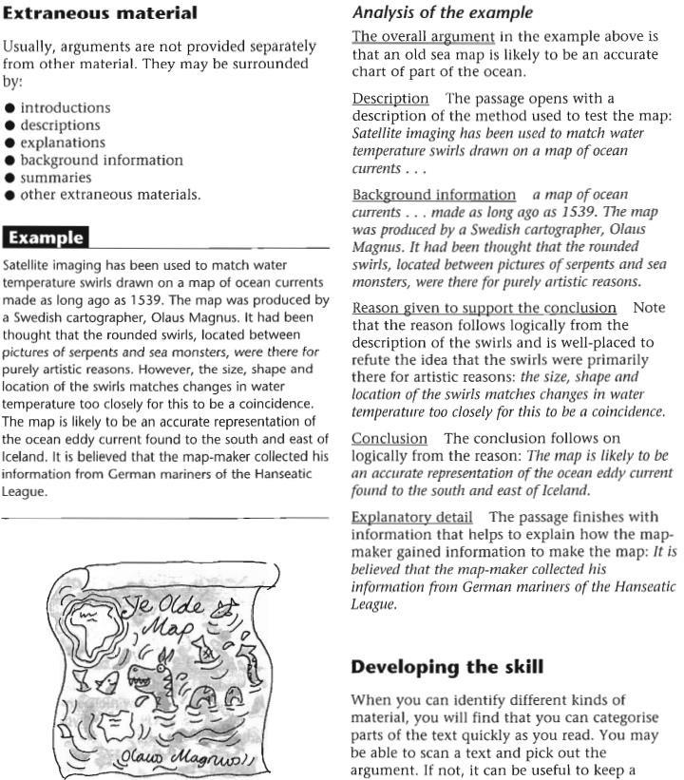
Distinguishing argument from other material

Slide 27
Argument and disagreement
▷ Argument is not the same as disagreement. You can disagree with someone else's position without pointing out why you disagree or persuading them to think differently.
▷ In critical thinking there is a distinction between position, an agreement, a disagreement, and an argument/.

Slide 28
Key Terms
▷ Position A point of view
▷ Agreement To concur with some-one else's point of view
▷ Disagreement To hold a different point of view from someone else
▷ Argument Using reasons to support a point of view, so that known or unknown audiences may be persuaded to agree. An argument may include disagreement, but is more than simply disagreement if it is based on reasons

Slide 29
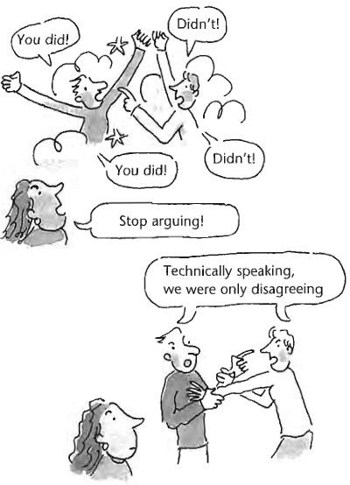

Slide 30

Example
▷ Position: Genetic engineering really worries me. I don't think it should be allowed. [No reasons are given so this is simply a position.

Slide 31
Example
▷ Agreement I: I don't know much about genetic engineering, but I agree with you.
▷ Agreement 2: 1 know a lot about this subject and I agree with you. [No reasons are given so these are simply agreements]

Slide 32
Example
▷ Disagreement: That doesn't convince me.
I think genetic engineering is really exciting. [No reasons are given so this is simply a disagreement.

Slide 33
Example
Argument: The possibilities for improving health and longevity through genetic engineering offer hope to sufferers of many conditions that currently don't have an effective cure. We should be pushing ahead to help these people as quickly as we can.

Slide 34
Argument Or disagreement?
Bilingualism and multilingualism confer many benefits. Speakers of more than one language have a better understanding of how languages are structured because they can compare across two different systems. People who speak only one language lack this essential point of reference. In many cases, a second language can help people to have a better understanding and appreciation of their first language.

Slide 35
Argument Or disagreement?
Several young people die each year training for the construction trades. Legislation is in place to cover health and safety at work, but some employers argue that this is too expensive to implement and onerous to monitor. They say that young people are not responsible enough at work and that there is nothing further they can do to prevent their deaths. That cannot be a good argument

Slide 36
Argument Or disagreement?
I cannot agree with people who say that smacking children does them no harm.Of course, it harms them, both physically and emotionally. Hitting another person is assault and it would not be tolerated against an adult. Many adults have no sense of the cruelty of smacking precisely because they were smacked themselves as children and erroneously regard this as normal. They then go on to assault other vulnerable people, perpetuating a vicious cycle

Slide 37
Non-arguments: Description
▷ Descriptions give an account of how something is done, or what something is like. They do not give reasoned accounts of how or why something occurred nor do they evaluate outcomes.
▷ In reports and academic writing, description should be factual, accurate and free of value judgements. Description is sometimes confused with critical analysis as both can investigate an issue in detail.
▷ Descriptive detail is not intended to persuade to a point of view but aims, rather, to give the audience a more thorough impression of the item or issue being described

Slide 38
Example
▷ The solution was placed in a test-tube and heated to 35" centigrade. Small amounts of yellow vapor were emitted. These were odorless. Forty milliliters of water were added to the solution, which was then heated until it began to boil. This time, grey steam was emitted. Water droplets gathered on the side of the test-tube.

Slide 39
Example Description
This describes the experiment. A
steps taken in an
of
careful description
methodological procedures is an important part of writing up any kind of experimental research. No reasons are given for what happened. That critical analysis of the results would be in a separate part of the report.

Slide 40
Distinguishing argument from other material

